Slide 1
Second-Order Methods

Slide 2
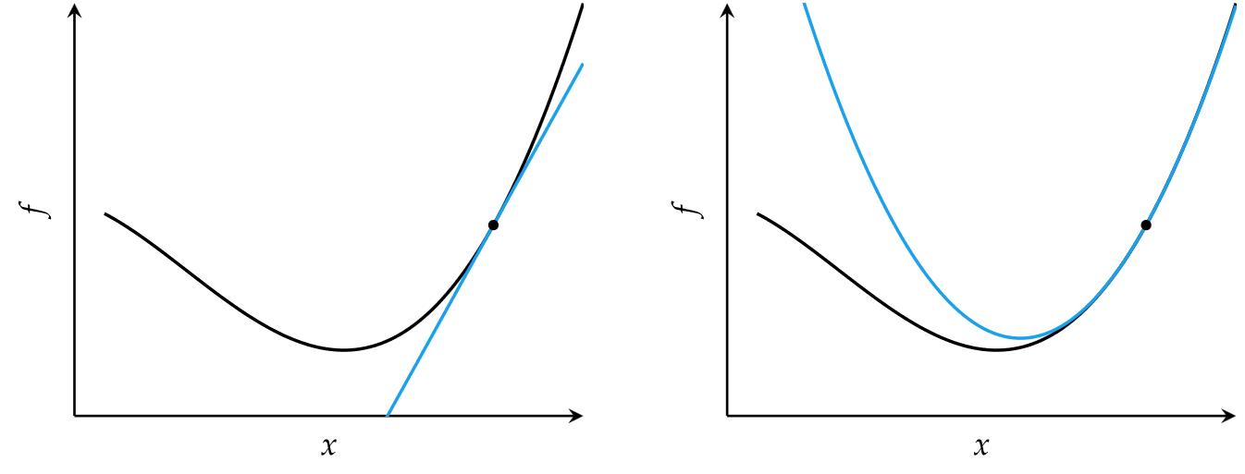




Slide 3
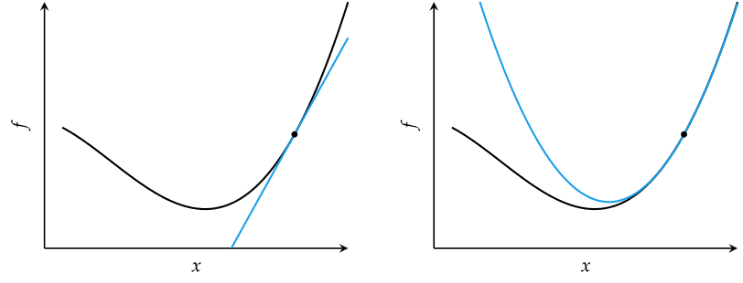

Second-Order Methods
Locally approximate function as quadratic
Comparison of first-order and second order approximations

Slide 4














Newton’s Method
Approximate a function using second-order Taylor series expansion
Univariate function

Slide 5






Slide 6





Newton’s Method
Multivariate function
Multivariate update rule
H is the Hessian matrix

Slide 7








Slide 8
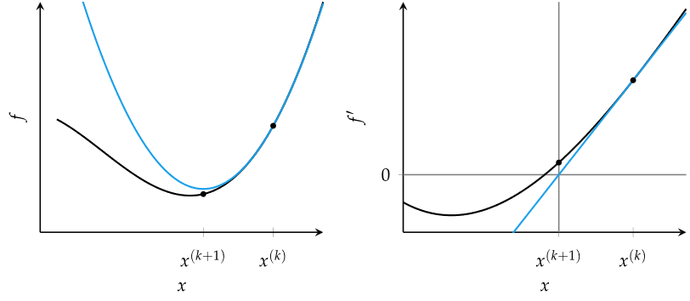






Newton’s Method
Newton’s method for optimization is equivalent to finding the roots of the derivative function

Slide 9
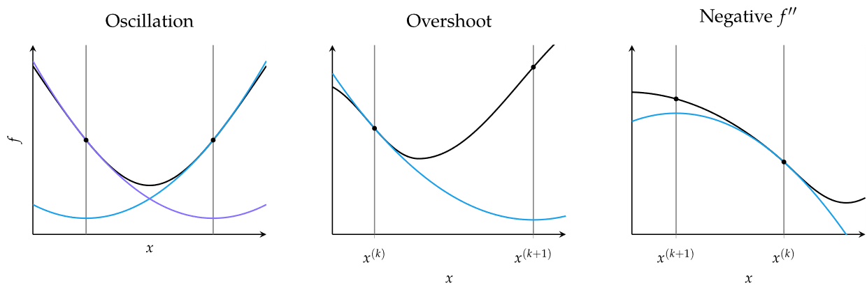























Newton’s Method
Common causes of error in Newton’s method

Slide 10







Slide 11


Secant Method
For univariate functions, if the second derivative is unknown, it can be approximated using the secant method
Update equation

Slide 12
Quasi-Newton Methods
For multivariate functions, the inverse Hessian may not be available or infeasible to compute, so can be approximated using a variety of Quasi-Newton methods, each appropriate in different circumstances
Davidon-Fletcher-Powell (DFP) method
Broyden-Fletcher-Goldfarb-Shanno (BFGS) method
Limited-memory BFGS (L-BFGS) method

